Slide 1
Website Ad-Click Assignment
Supriyo Barik – Ivy Professional school

Slide 2
Business problem overview

Slide 3
OBJECTIVE
1) We got the dataset called “Web_data.csv”. For this project, we have received various months of data in the year 2020. It is already being provided the clicked and non-clicked visit_id. Here, the goal is to Predict who is likely going to click on the Advertisement so it can contribute to more revenue generation to the organization.
2) Considering this objective of the project, we are running a Logistic Regression on Clicked (Y). The target is to analyze the influence of several independent factors (Time_Spent, Age, Avg_Income, Internet_Usage, Ad_Topic, Country_Name, City_code, Male, Time_Period, Weekday, Month, and Year) that affect dependent variable Y.

Slide 4
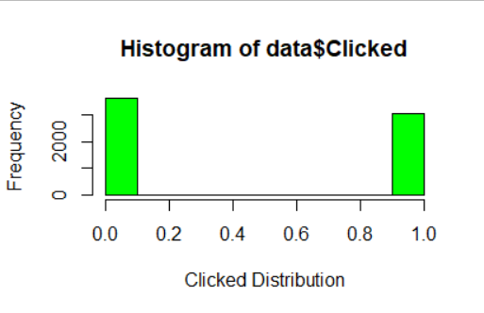
DEPENDENT VARIABLE
*** The dependent variable/target variable is clicked. It is a categorical column with 0 and 1. 0 means not clicked, and 1 means clicked that ad.
*** Graphical representations of the target variable:

Slide 5
Count of variables and observations
*** The Structure of the dataset is 6657 obs. of 14 variables.

Slide 6
Univariate analysis

Slide 7
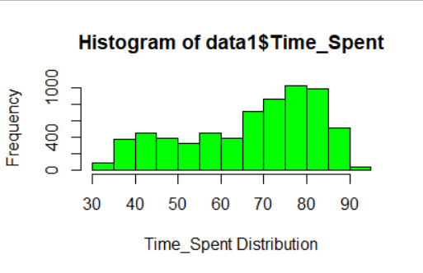
Time_Spent column
It is a negatively skewed data distribution (left)
Most of the data fall under 75 to 85 mins
It is the average time spent by the user on the website

Slide 8
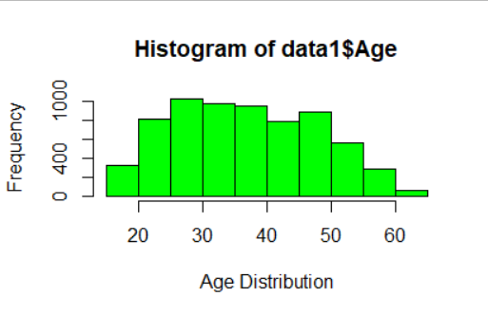
Age Column
It is a normal distribution
Most of the data fall under 25 to 50 years
It is the user’s age in years

Slide 9
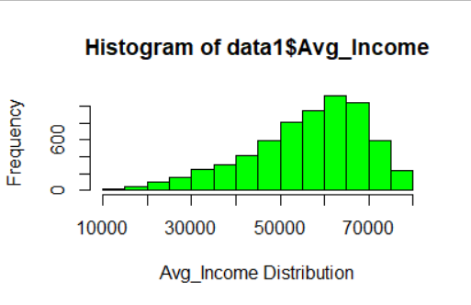
Avg_income column
It is a negatively skewed data distribution (left)
Most of the data fall under 5000 to 7000
It is the average Income of the geographical area of the user

Slide 10
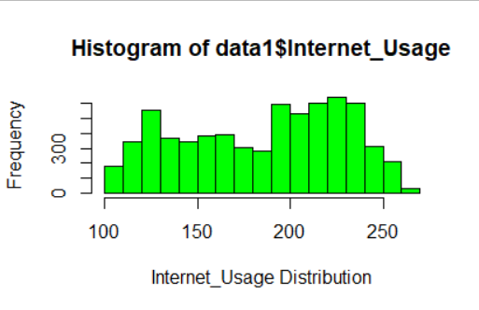
Internet_Usage column
It is a non-uniform random distribution
Most of the data fall under 190 to 240 mins
It is the average minutes a day user spent on the internet

Slide 11
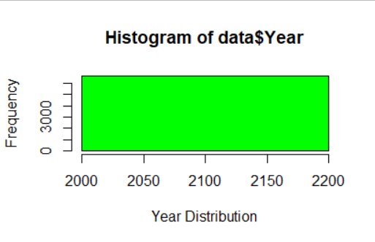
Year column
It is a uniform distribution
All values are 2020
It means in which year the data is collected

Slide 12
Bivariate analysis

Slide 13
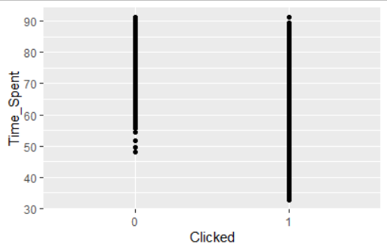
Time_spent vs click
The scatter plot signifies that visitors have clicked the ad most of the time at any duration.
As we build the logistic model, this column will play a vital role where Y=1.

Slide 14
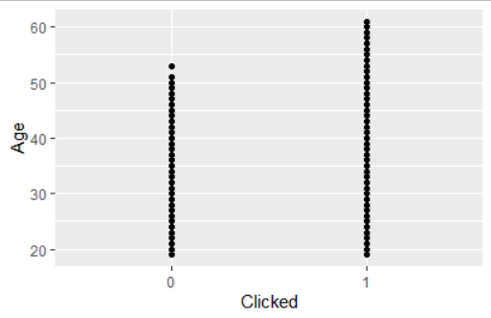
Age vs click
The scatter plot signifies that visitors have clicked the ad most of the time at random ages.
As we build the logistic model, this column will play a vital where for Y=1.

Slide 15
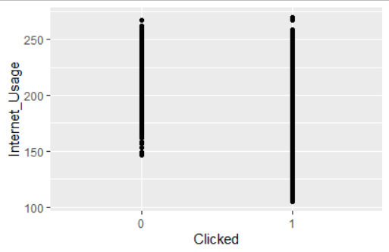
INternet_usage vs click
The scatter plot signifies that visitors have clicked the ad most of the time surfing the internet.
As we build the logistic model, this column will play a vital role where Y=1.

Slide 16
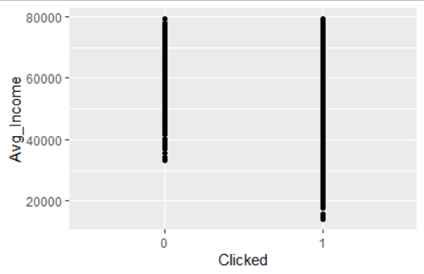
Avg_Income VS click
The scatter plot signifies that visitors have clicked the ad most of the time at any range of average income.
As we build the logistic model, this column will play a vital role where Y=1.

Slide 17
Model building and Outcome

Slide 18
potential VARIABLES
Time_Spent
Age
Avg_Income
Internet_Usage
Ad_Topic (product_3, product_8, product_21, and product_28)
City_code (City_2, City_3, City_4, City_5, City_6, and City_7)
Time_Period (Mid-Night and Morning)
*** These are significant variables also (selected after removing the variables with high multicollinearity from the model)

Slide 19
Variable importance
Based on the potential variables, the top three most important variables are
Internet_Usage
Age
Avg_Income

Slide 20
Observations from the confusion matrix

Slide 21
Diagnostic Test values
1) Actual 0 1
Predicted 0 1049 87
1 37 824
2)
AUC matrix:
Metric Values
threshold 0.5365780
specificity 0.9045005
sensitivity 0.9659300
AUC 0.9653539
AccuracyRate 0.9379069
Gini 0.9307078

Slide 22
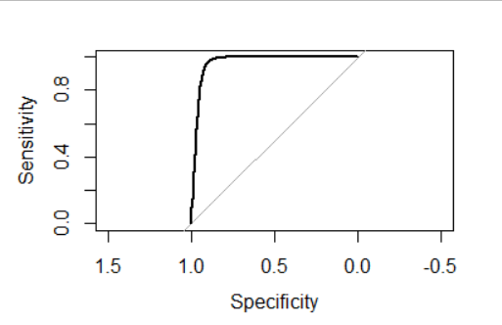
Diagnostic Test values with Roc_curve
Precision value of the model: 0.95
Accuracy of the model: 0.93
Recall value of the model: 0.04
f1 score of the model: 0.08
Roc_curve :

Slide 23
Business RECOMMENDATIONs

Slide 24
Recommendations
The number of visitors who are spending more time is more likely to click the ad than those who are spending less time on the internet
Age has a positive impact hence visitors of any age are more likely to click the ad
The number of visitors who have a high average income is more likely to click the ad than those who have a less average income
The number of visitors who are using more internet is more likely to click the ad than those who are using less internet
In the Ad_Topic, product_3 is more likely to click the ad than the headline of the advertisement product_1
In the Ad_Topic, product_8 is more likely to click the ad than the headline of the advertisement product_1

Slide 25
Recommendations (Cont.)
In the Ad_Topic, product_21 is more likely to click the ad than the headline of the advertisement product_1
In the Ad_Topic, product_28 is more likely to click the ad than the headline of the advertisement product_1
In the city_code, the user from city_2 is more likely to click the ad than the user in city_1
In the city_code, the user from city_3 is more likely to click the ad than the user in city_1
In the city_code, the user from city_4 is more likely to click the ad than the user in city_1

Slide 26
Recommendations (Cont.)
In the city_code, the user from city_5 is more likely to click the ad than the user in city_1
In the city_code, the user from city_6 is more likely to click the ad than the user in city_1
In the city_code, the user from city_7 is more likely to click the ad than the user in city_1
Mid-Night time_period is more likely time to click the ad than Early-Morning Time_period
Morning time_period is more likely time to click the ad than Early-Morning Time_period.

Slide 27

THANK YOU

